Slide 1
Why Does My Computer Do That? Intro to Coding with Python– Lists
Dr. Ab Mosca (they/them)
Slides based off slides courtesy of Jordan Crouser (https://jcrouser.github.io/)

Slide 2
Plan for Today
String recap
Lists
the basics
iterating
methods

Slide 3
Recap: storing stuff in memory
collections of things in “numbered boxes”

Slide 4
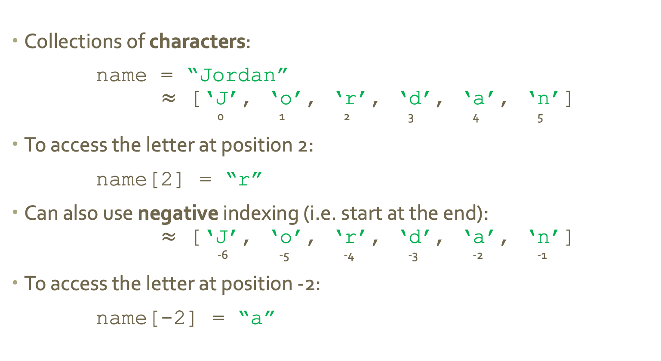
Recap: strings
Collections of characters:
name = “Jordan”
$≈$ [‘J’, ‘o’, ‘r’, ‘d’, ‘a’, ‘n’]
0 1 2 3 4 5
To access the letter at position 2:
name[2] = “r”
Can also use negative indexing (i.e. start at the end):
$≈$ [‘J’, ‘o’, ‘r’, ‘d’, ‘a’, ‘n’]
-6 -5 -4 -3 -2 -1
To access the letter at position -2:
name[-2] = “a”

Slide 5
Check in
There are two ways to access the last letter in a string: what are they?
Notes:
s[len(s)-1]
s[-1]

Slide 6
Recap: slicing strings
Sometimes we want to access a specific part of the string (more than a single letter, but less than the whole thing)
e.g. to access the letters in positions 3 through 5:
s = “Computer Science”
s[3:6] = “put”
This is called slicing
remember:
not inclusive

Slide 7
Recap: slicing strings
Special slices:
s = “Computer Science”
s[:9] = “Computer”
s[10:] = “Science”
“start at the beginning”
“continue until the end”

Slide 8
Okay, so…
strings are collections of characters
defined using
“ quotes “

Slide 9
Okay, so…
lists are collections of objects
defined using
[ square brackets ]

Slide 10
Okay, so…
lists are collections of objects
defined using
[ square brackets ]
i.e. just about
anything

Slide 11
list of integers
[ 1, 2, 3, 4, 5, 6 ]

Slide 12
list of floats
[ 1.2, 3.5, 0.7, 7.8 ]

Slide 13
list of strings
[ “dog”, “cat”, “pig” ]

Slide 14
Indexing a list
[ “dog”, “cat”, “pig” ]
0 1 2
just
like with
strings

Slide 15
Indexing a list
-3 -2 -1
[ “dog”, “cat”, “pig” ]
0 1 2
negative
works
too

Slide 16
Weird python thing
in python, lists can contain mixed types:
[ 1, “cat”, 7.8 ]
this is
not allowed
in many other languages
(so be careful!)

Slide 17
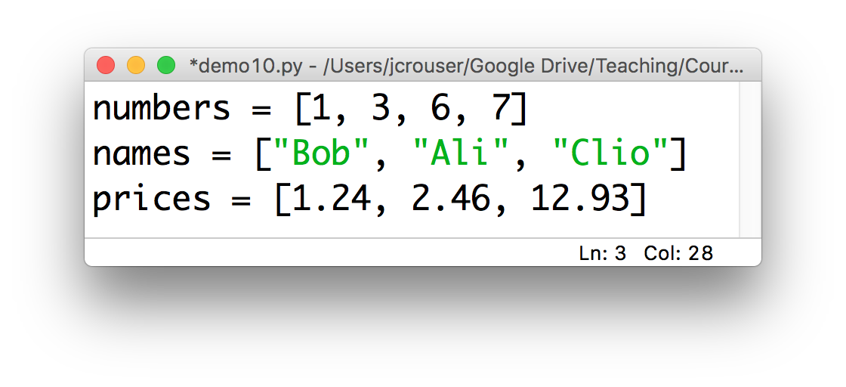
Naming convention
Remember: it’s always a a good idea variable names to be descriptive
Because lists contain collections of things, we’ll generally label them with a plural noun, e.g.

Slide 18
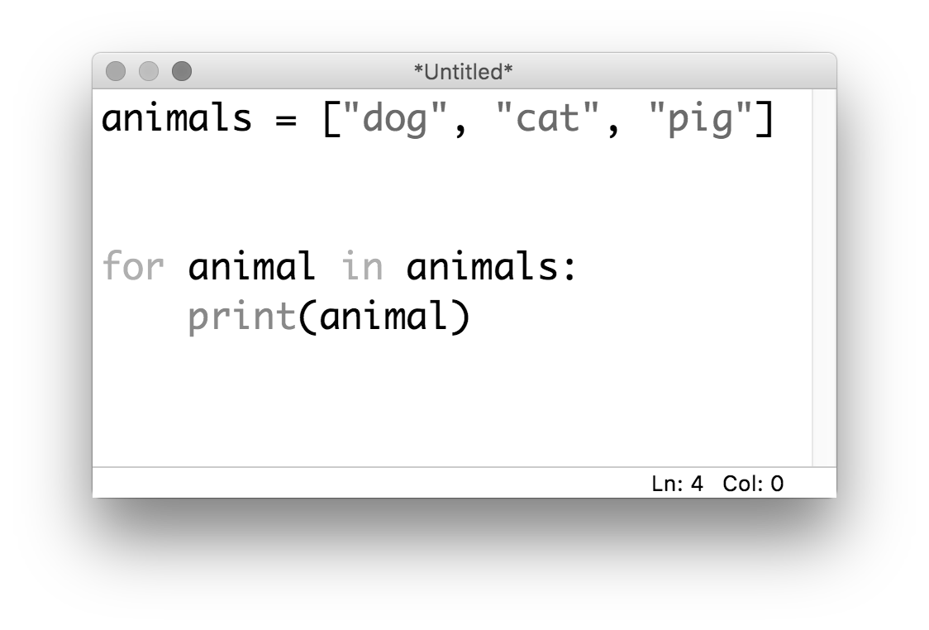
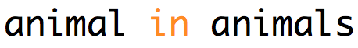
Iterating through items in a list

Slide 19
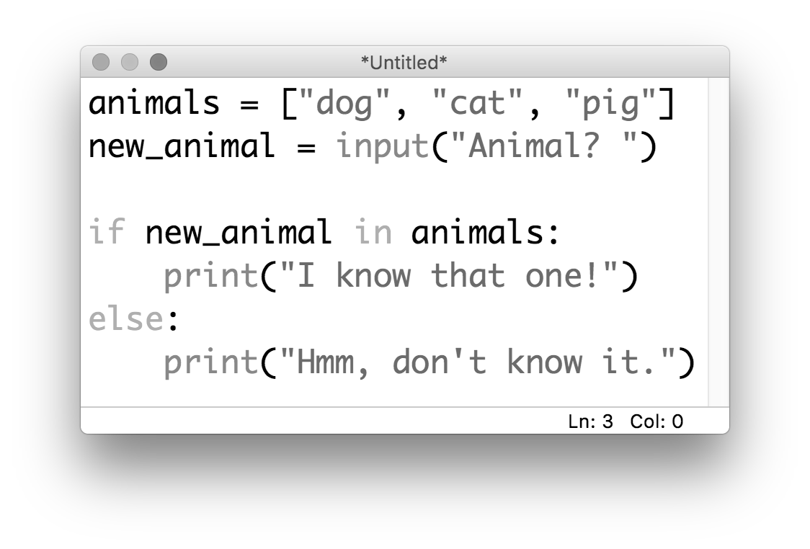
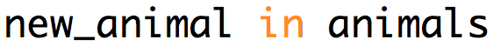
Checking membership in a list

Slide 20
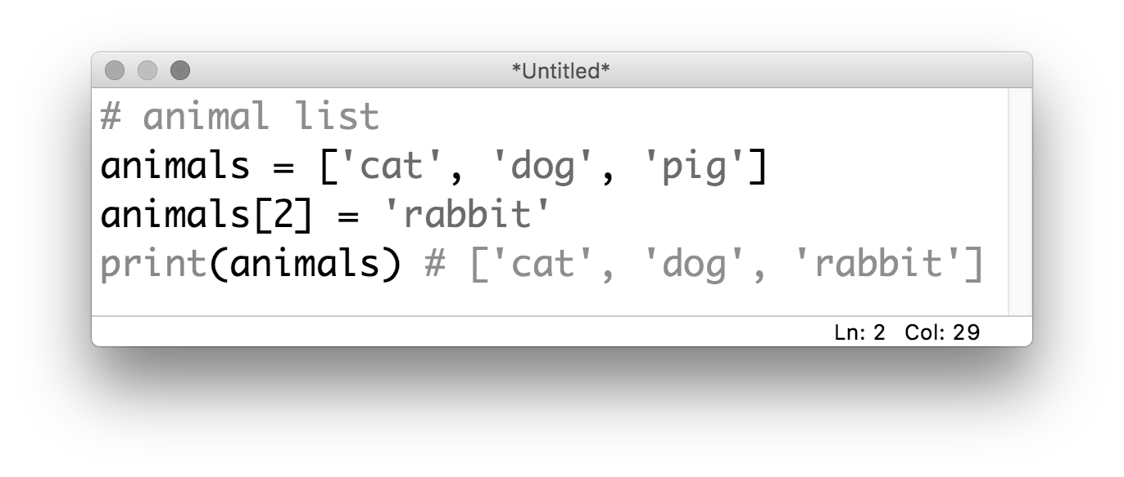
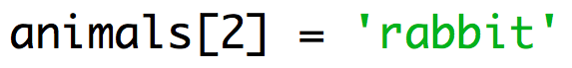
Overwriting an item in a list
If we want to overwrite an item in a list, we can use indexing combined with the = operator:

Slide 21
Discussion
What happens when we try to do this
with a string?

Slide 22
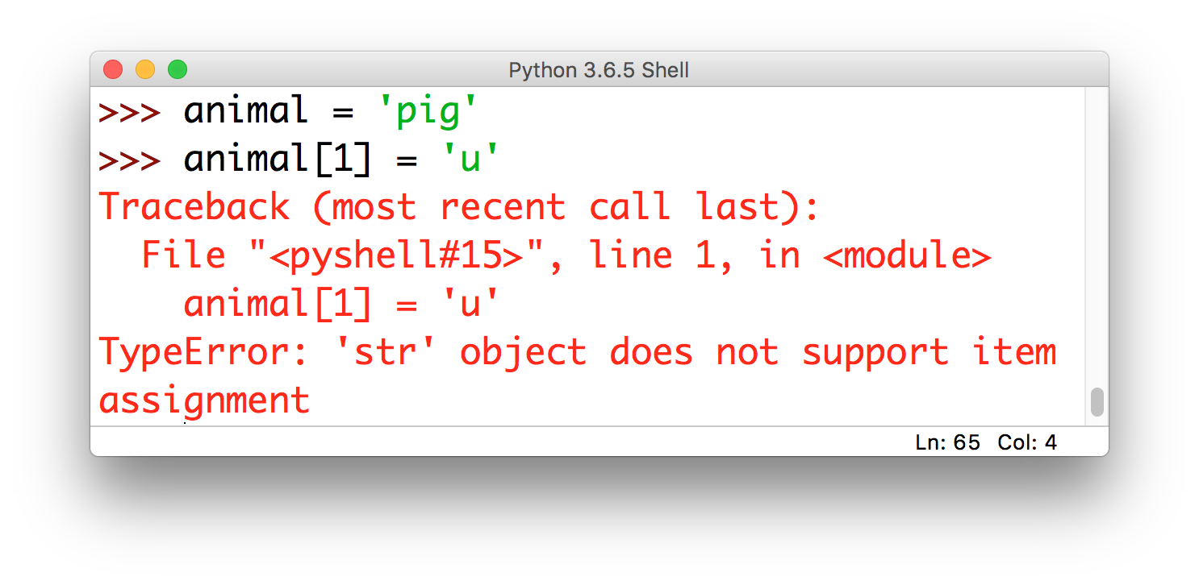
Discussion

Slide 23
mutable vs. immutable
strings are immutable (which means we cannot change them in memory, we have to overwrite them completely)
lists defined with […] are mutable (which means we can change them in memory)
if we want an immutable lists, we can define them with (…) instead

Slide 24
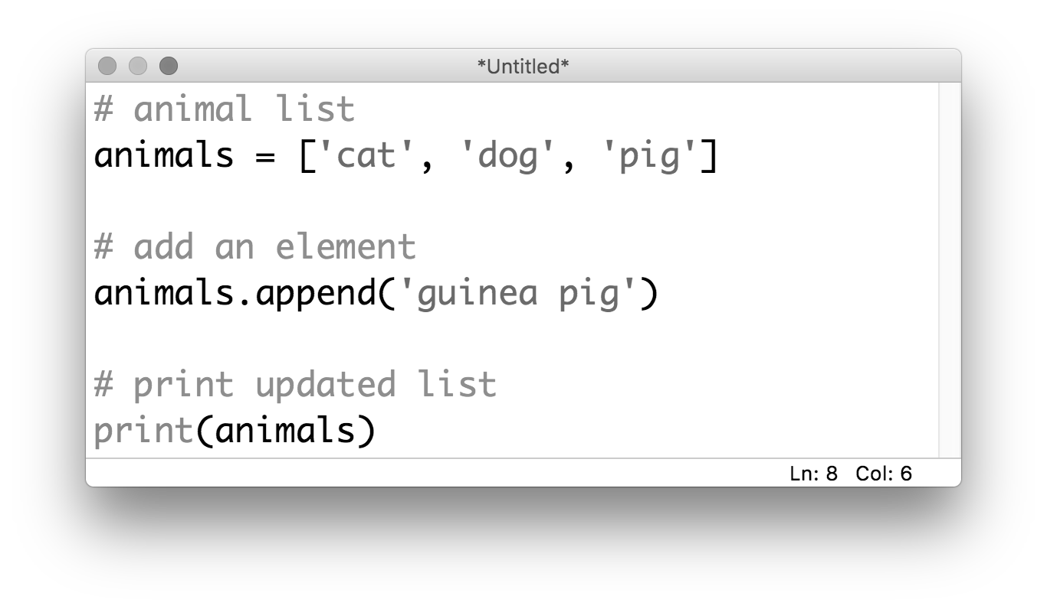
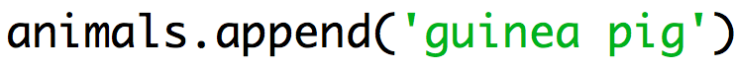
list methods: .append()
If you want to add a new item to the end of a list:

Slide 25
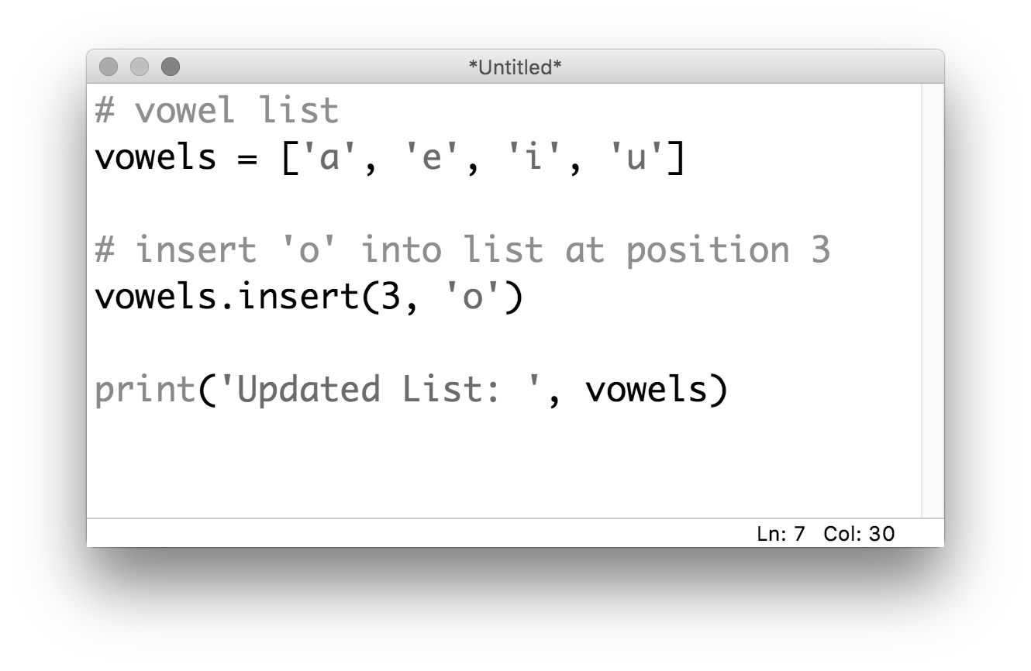
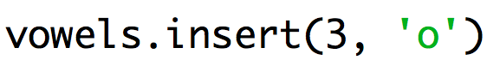
list methods: .insert()
If you want to add a new item into a list at a specific position:

Slide 26
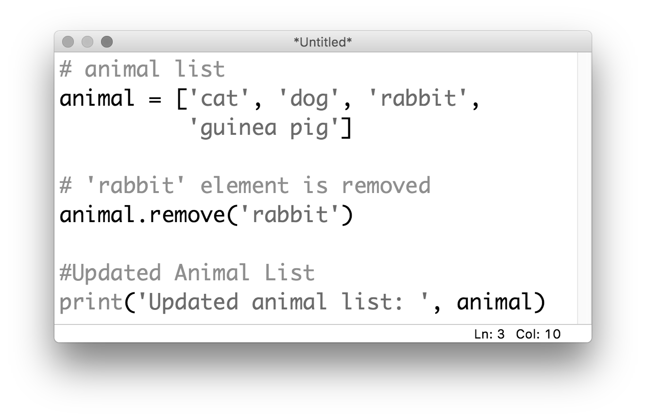
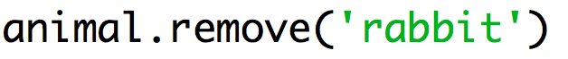
list methods: .remove()
If you want to remove an item from a list:

Slide 27
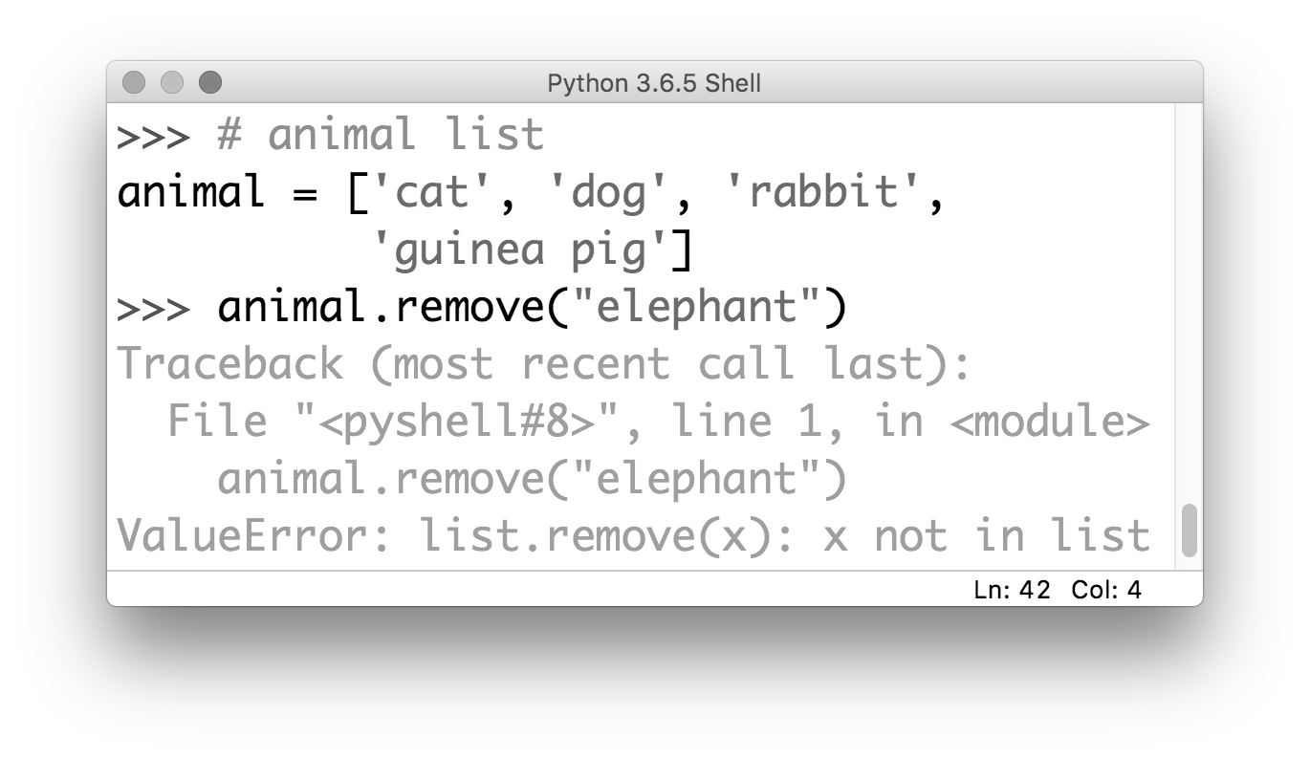
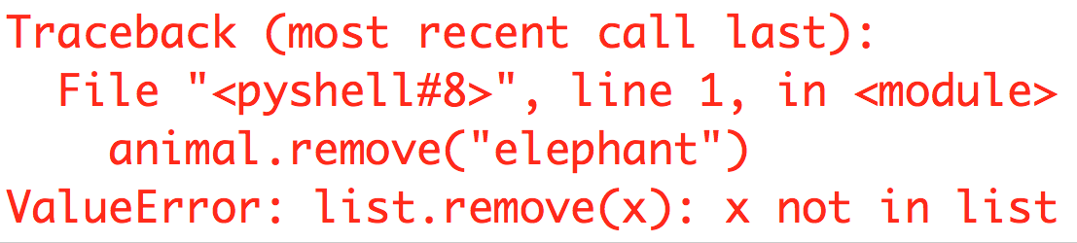
list methods: .remove()
If you try to remove an item that isn’t in the list, the interpreter will throw a ValueError:

Slide 28
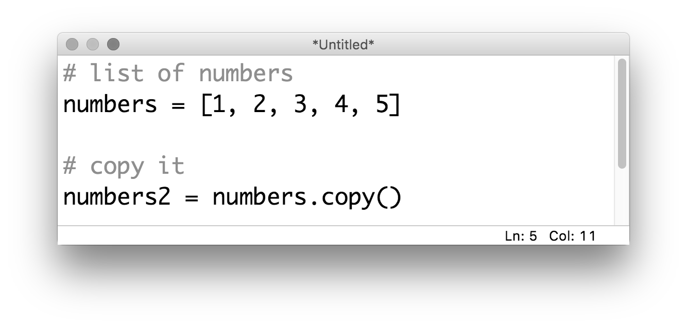
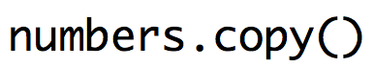
list methods: .copy()
If you want to copy the list:

Slide 29
list methods: .copy()
If you want to copy the list:
wait… why?

Slide 30
An important note about copying a list
Usually when we want to copy a string or a number, we just say something like:
x2 = x1
Copying a list this way, both the original and the copy point to the same spot in memory
This can cause some unexpected behavior… remember when we said lists were mutable?

Slide 31
An important note about copying a list
Let’s say we have a list stored in memory: names = [“Ben”, “Ali”, “Clio”]
names
… | “Ben” | “Ali” | “Clio” | …

Slide 32
An important note about copying a list
Let’s say we have a list stored in memory: names = [“Ben”, “Ali”, “Clio”]
And then we say names2 = names
names
names2
… | “Ben” | “Ali” | “Clio” | …

Slide 33
An important note about copying a list
Let’s say we have a list stored in memory: names = [“Ben”, “Ali”, “Clio”]
And then we say names2 = names
If we then say:
names2[0] = “Joe”
names
names2
… | “Ben” | “Ali” | “Clio” | …

Slide 34
An important note about copying a list
Let’s say we have a list stored in memory: names = [“Ben”, “Ali”, “Clio”]
And then we say names2 = names
If we then say:
names2[0] = “Joe”
names
names2
… | “Joe” | “Ali” | “Clio” | …

Slide 35
An important note about copying a list
Let’s say we have a list stored in memory: names = [“Ben”, “Ali”, “Clio”]
And then we say names2 = names
If we then say:
names2[0] = “Joe”
names
names2
… | “Joe” | “Ali” | “Clio” | …
What happens if we then ask for names[0]?

Slide 36
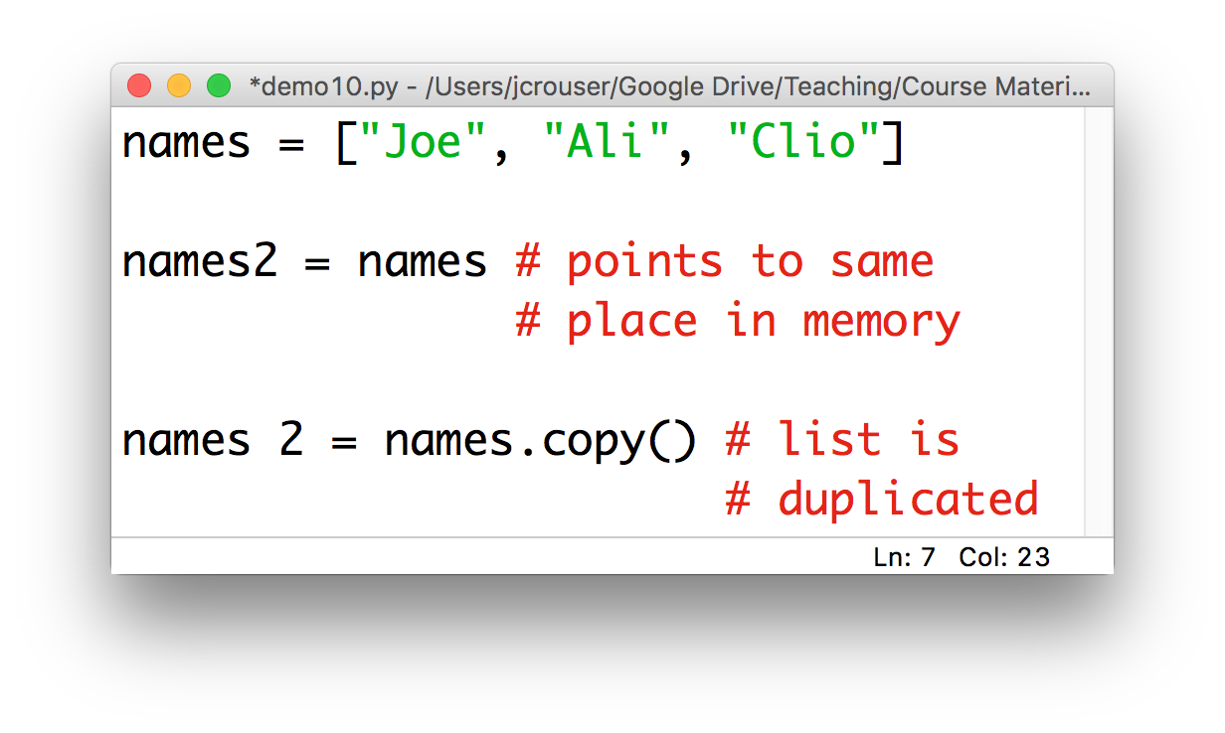
Recap: copying lists

Slide 37
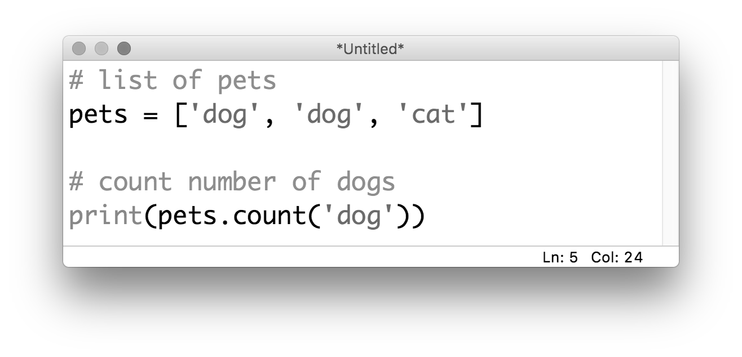
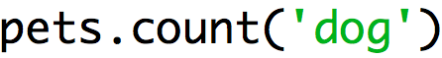
list methods: .count()
If you want to count how many times an item appears in the list:

Slide 38
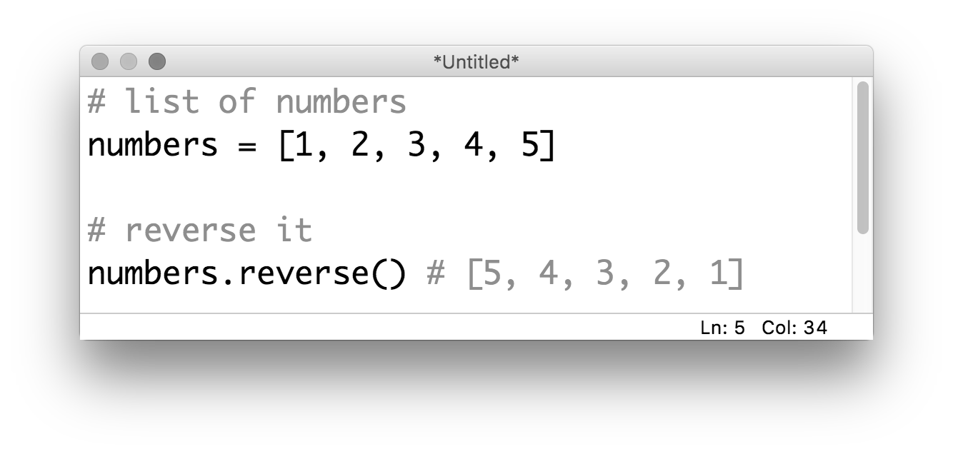
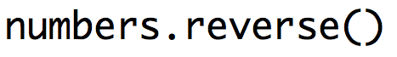
list methods: .reverse()
If you want to reverse the list:
this changes
the original list!

Slide 39
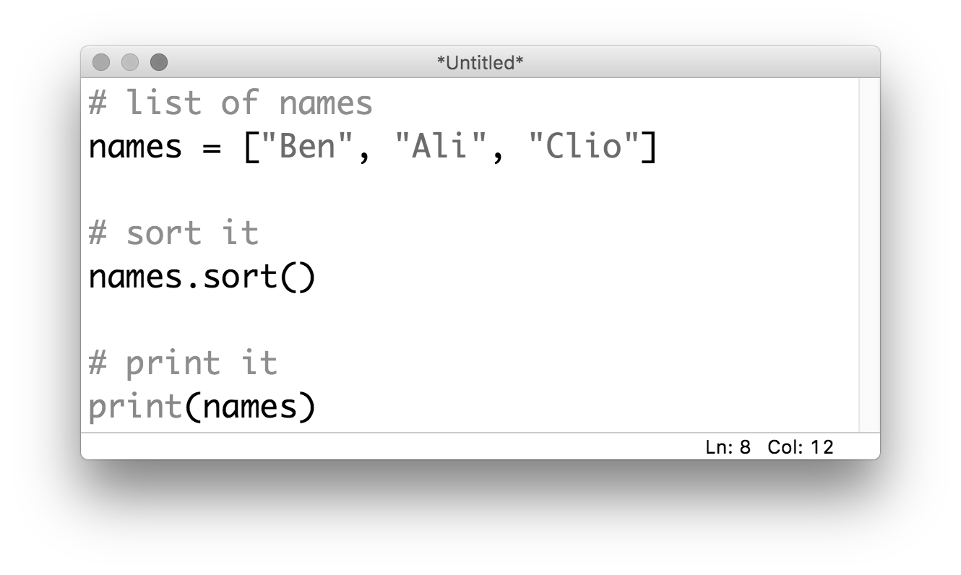
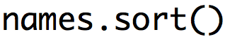
list methods: .sort()
If you want to sort the list:
this also changes
the original list!

Slide 40
15-minute exercise:
Write a program that:
asks the user to input() names one at a time
adds each new name to a list called friends
and after each new name is added prints the list in alphabetical order
The program should loop until the user types “DONE”

